Slide 1
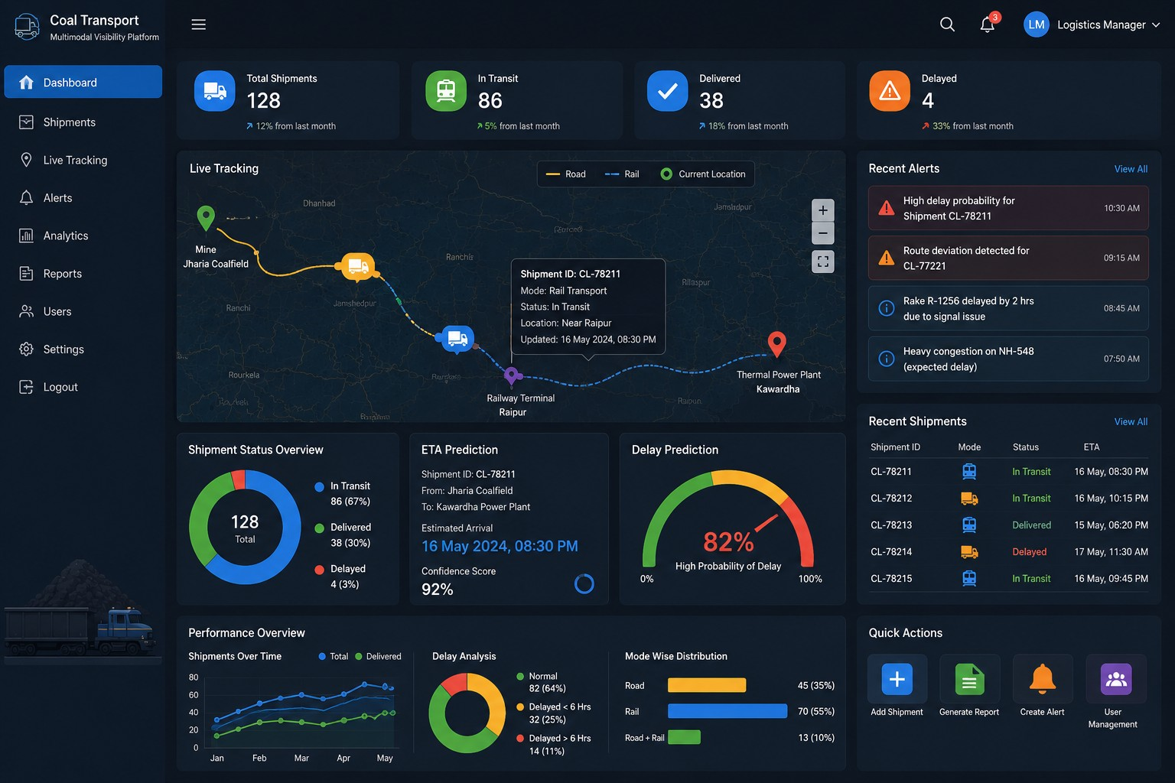
DEVELOPMENT OF A DIGITAL PLATFORM
FOR MULTIMODAL VISIBILITY OF COAL TRANSPORTATION
Mini Project • Review 1 • Semester VII
GUIDED BY
Prof. Nayana R
School of Computer Science & Engineering
TEAM MEMBERS
Nandini — 20231CSE0421
Manaswi Bhujange — 20231CSE0430
Biradar Ashwini — 20231CSE0400
PRESIDENCY UNIVERSITY
Bengaluru • Karnataka
1

Slide 2
2. PROJECT OVERVIEW
What the platform is designed to solve and how it creates value
A centralized cloud-based platform to monitor coal shipments moving through road, rail, or a combination of both.
PROBLEM
PROPOSED SOLUTION
KEY BENEFITS
Shipment information is spread across multiple transport stages.
Delays and disruptions can be identified too late.
Manual monitoring makes coordination difficult.
Decision-makers need one clear view of shipment status.
Centralize shipment and transportation-event data.
Provide a single dashboard for road + rail visibility.
Use AI for delay and ETA prediction.
Use cloud infrastructure for storage and access.
Better visibility across the shipment journey.
Less manual tracking and fewer information gaps.
Faster response to predicted delays.
Data-driven operational decisions.
2

Slide 3
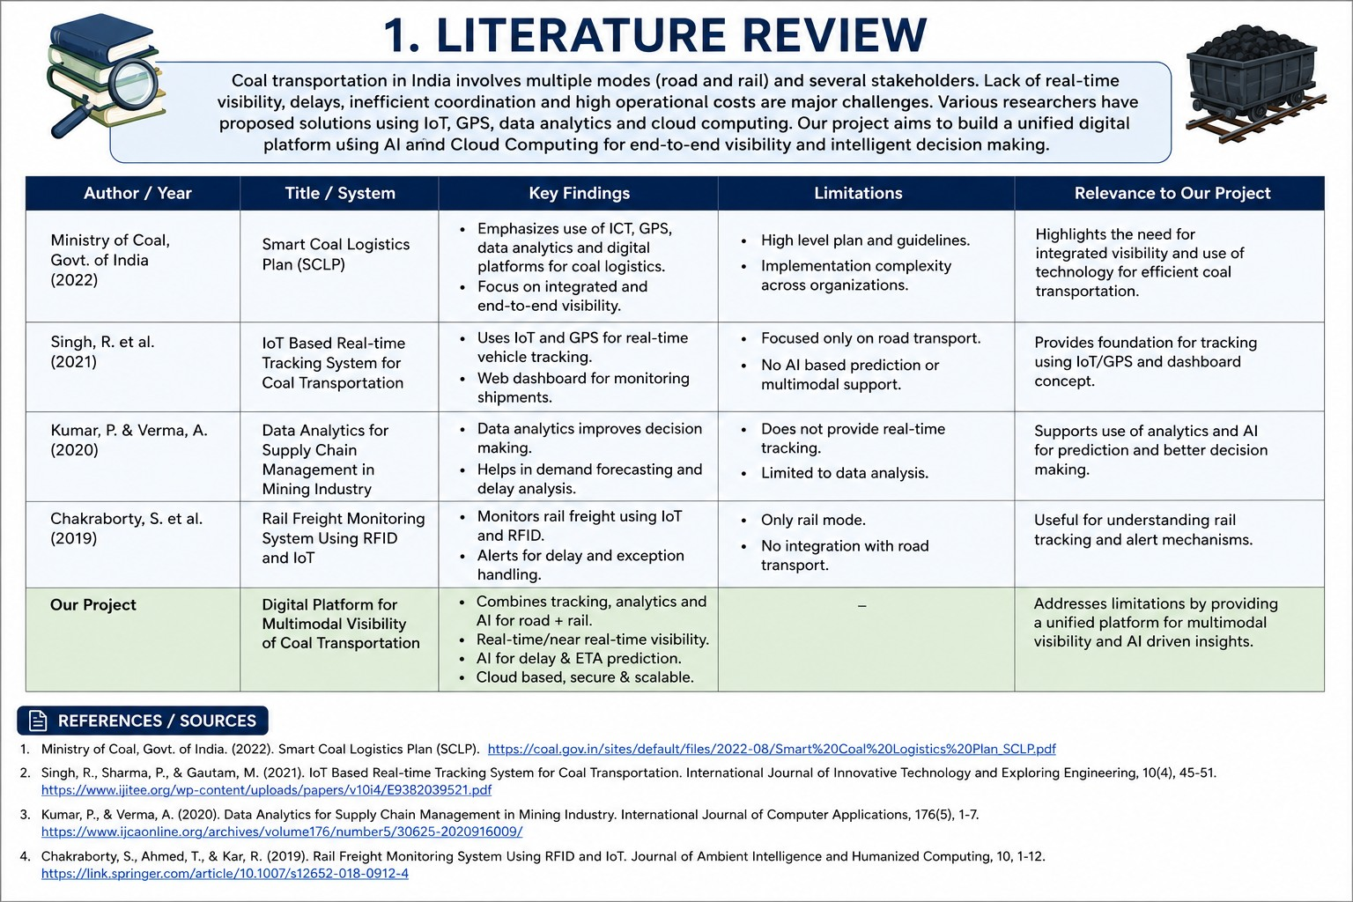
3. LITERATURE REVIEW
Research background and identified gap
3

Slide 4
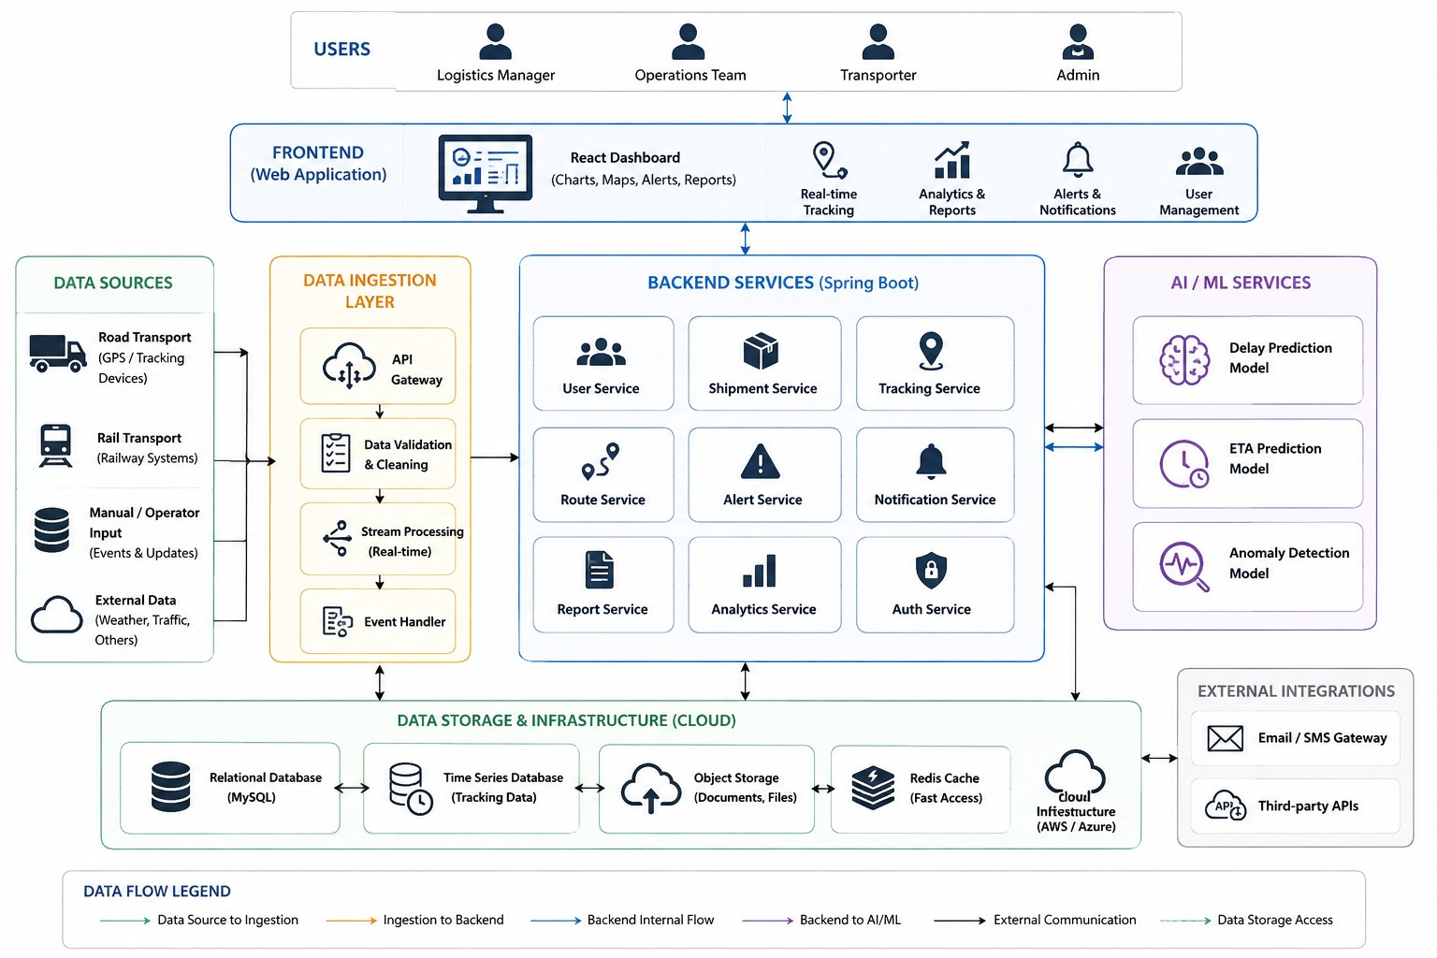
4. ARCHITECTURE DESIGN
System-level view of users, data, application services, AI/ML and cloud infrastructure
4

Slide 5
5. ARCHITECTURE — PROPOSED REFINEMENTS
Changes that keep the prototype software-focused and realistic
1 TRACKING DATA
2 SIMPLER CLOUD STACK
Use shipment / transportation-event updates as the prototype data source.
GPS or external live feeds can be integrated later when available.
Keep MySQL as the core application database.
Add cloud hosting/storage only where it provides clear value.
3 AI / ML LAYER
4 RELIABLE DATA FLOW
Train prediction models using historical shipment data.
Generate delay probability and estimated arrival time.
Validate incoming updates before storing them.
Keep the latest known shipment status visible when new data is unavailable.
Core flow: Data → Spring Boot Backend → MySQL / AI → React Dashboard
5

Slide 6
6. EXPECTED OUTPUT
Prototype dashboard showing shipment visibility, predictions, alerts and analytics
6

Slide 7
7. GANTT CHART
Planned development from 08 August to 20 November 2026
AUG
SEP
OCT
NOV
Project orientation & requirements
Literature review & architecture
UI / React dashboard
Spring Boot backend + MySQL
AI delay & ETA module
Cloud integration & testing
Integration, documentation & PPT
Final testing & submission
Project start • 08 Aug 2026
Review 1 • 29 Aug 2026
Target completion • 20 Nov 2026
7

Slide 8
8. KEY TAKEAWAYS
What the review demonstrates
PROJECT IN ONE LINE
A cloud-based digital platform that brings coal shipment information from multiple transport stages into one place and adds AI-based decision support.
TECHNOLOGY STACK
EXPECTED DEMONSTRATION
Frontend: React + JavaScript
Backend: Java + Spring Boot
Database: MySQL
AI/ML: delay & ETA prediction
Cloud: application/data hosting
Create and manage shipments.
Record road / rail transportation events.
View latest known status and route.
Show AI-based delay / ETA prediction.
Display alerts, reports and analytics.
8

Slide 9
THANK YOU
Questions & Discussion
Development of a Digital Platform for Multimodal Visibility of Coal Transportation
Nandini • Manaswi Bhujange • Biradar Ashwini

